Slide 1

CS361: Computer Architecture
Cache: A deep Dive
Week 8 Lec 2: Memory
Cache Coherence
CS324 Computer Architecture 1

Slide 2
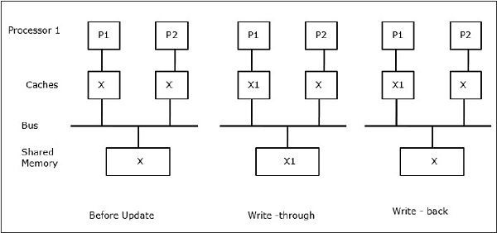

Slide 3
Cache Coherence
Cache coherence is the principle that ensures that multiple caches in a system, each storing a copy of the same memory location, are kept in sync.
It guarantees that all processors see a consistent view of memory despite the presence of local caches.
Maintaining cache coherence is essential for data consistency and program correctness.
Notes:
Cache coherence refers to the consistency of data stored in different caches that mirror the same data in a computer system. In a multiprocessor or multicore system, each processor or core typically has its own cache to store frequently used data. However, when multiple caches are involved, it becomes crucial to ensure that the copies of data in different caches are synchronized and consistent.
The primary goal of cache coherence is to prevent data inconsistencies that may arise due to multiple caches storing the same data

Slide 4
The MESI Protocol
Your laptop's CPU almost certainly uses this. Every single cache line (a 64-byte chunk of data) in a core's cache is tagged with one of four states:
M - Modified: This cache has the only valid copy, and it is dirty (it has been changed and is different from main memory). If another core asks for this, this cache must provide it (and write it back to memory).
E - Exclusive: This cache has the only valid copy, and it is clean (it matches main memory). It can be changed to M at any time without telling anyone.
S - Shared: Multiple caches have a copy of this data, and it is clean. If a core wants to write to this, it must first tell all other sharers to invalidate their copies.
I - Invalid: This cache line's data is garbage. It's not valid and cannot be read.

Slide 5
Cache Coherence Techniques
Cache coherence is achieved through various techniques, with two common approaches being Snoopy and Directories.
These techniques manage the communication between caches and ensure data consistency across multiple processors.

Slide 6
Snoopy Cache-Coherency Protocols
Bus is a broadcast medium
Caches know what they have
Cache controller “snoops” all transactions on shared bus
relevant transaction if for a block its cache contains
take action to ensure coherence
invalidate, update, or supply value
depends on state of the block and the protocol
Notes:
When a core (let’s call it the "faulting processor") needs to access a memory location, it sends a broadcast message (called a "search probe") over the shared bus.
All other cores listen to this message (they "snoop" on the bus).
If another core has the requested data, it responds and takes the necessary action (e.g., sending the data or invalidating its copy).

Slide 7
Snoopy Cache Coherence
Snoopy cache coherence is a distributed approach where each cache snoops or monitors the bus for memory operations.
When a cache detects a memory operation that affects its cached data, it takes appropriate actions to maintain coherence.
Snoopy protocols are often used in smaller-scale systems.
Example: Imagine a watchful friend in a group who keeps an eye on everyone's actions. If someone takes or updates information, this friend immediately informs others to keep everyone in sync.

Slide 8
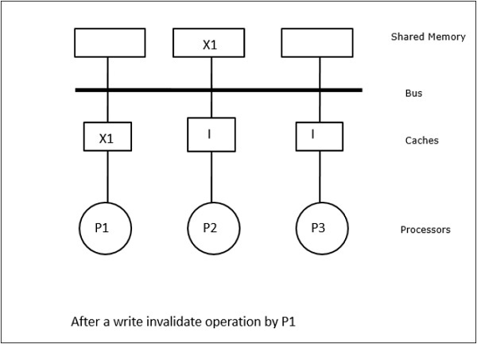
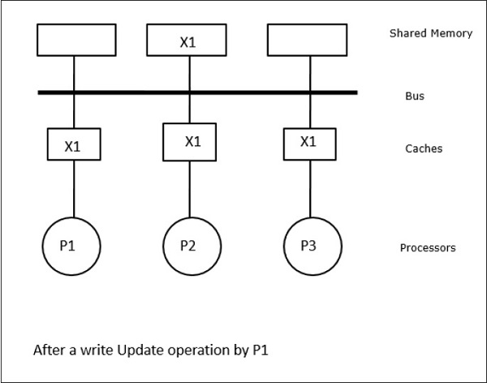
Invalidate and update operation

Slide 9
Directory based: more scalable
Every memory block has associated directory information
keeps track of copies of cached blocks and their states
on a miss, find directory entry, look it up, and communicate only with the nodes that have copies if necessary
in scalable networks, communication with directory and copies is through network transactions
Many alternatives for organizing directory information

Slide 10
Directory-Based Cache Coherence
Directory-based cache coherence relies on a central directory that keeps track of the status of data blocks in the system.
Caches communicate with the directory to request and update data.
This approach is commonly used in larger multi-core and multi-processor systems.
Example: Think of a supervisor in an office who maintains a directory of tasks. Employees must check with the supervisor before starting a task to ensure coordination and avoid conflicts.

Slide 11
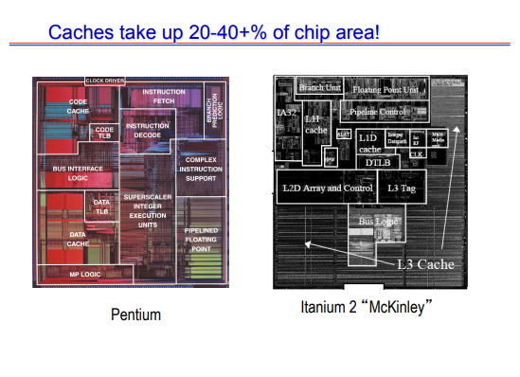
Improving caches???

